Slide 1

FIR Simplification and Discrepancy Detection
Team : D16
SI no. | Name | USN
1. | Anuja H | 01FE23BCS263
2. | Gurulingamma V B | 01FE23BCS282
3. | Sahana Sulegavi | 01FE23BCS300
4. | Rashmi Khot | 01FE24BCS408
GUIDE: Guruprasad Hiremath

Slide 2

Problem Statement :
First Information Reports (FIRs) often contain complex legal language that is difficult for common citizens to understand. This project aims to develop an AI-powered system that simplifies FIR content, identifies relevant IPC/BNS sections, and explains them in plain language. The solution also detects discrepancies between the complainant's statement and the FIR narrative while providing multilingual support for improved accessibility and transparency.
Objectives:
To extract information from FIR PDF documents automatically.
To identify IPC/BNS sections and explain their legal meaning.
To convert complex legal language into simple and understandable language.
To provide AI-based analysis of FIR cases.
To translate FIR explanations into Kannada and Hindi.
To compare the citizen's complaint with the FIR and detect discrepancies.
To improve legal awareness and make FIRs easier for citizens to understand.

Slide 3
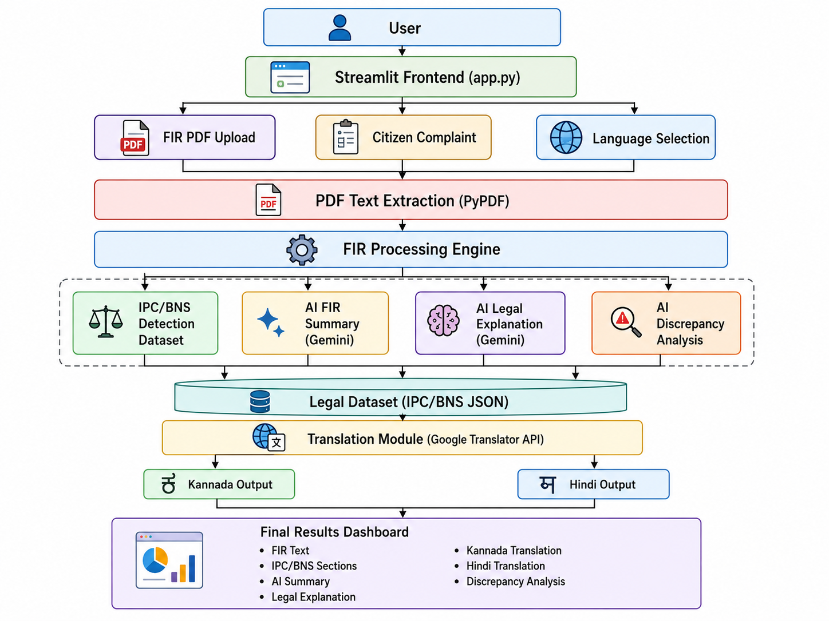
Architecture:

Slide 4
Technologies Used:
Frontend : Streamlit
PDF Processing: PyPDF
Dataset : IPC/BNS JSON Dataset
Generative AI : Gemini 2.5 Flash
Translation : Deep Translator
Language : Python

Slide 5
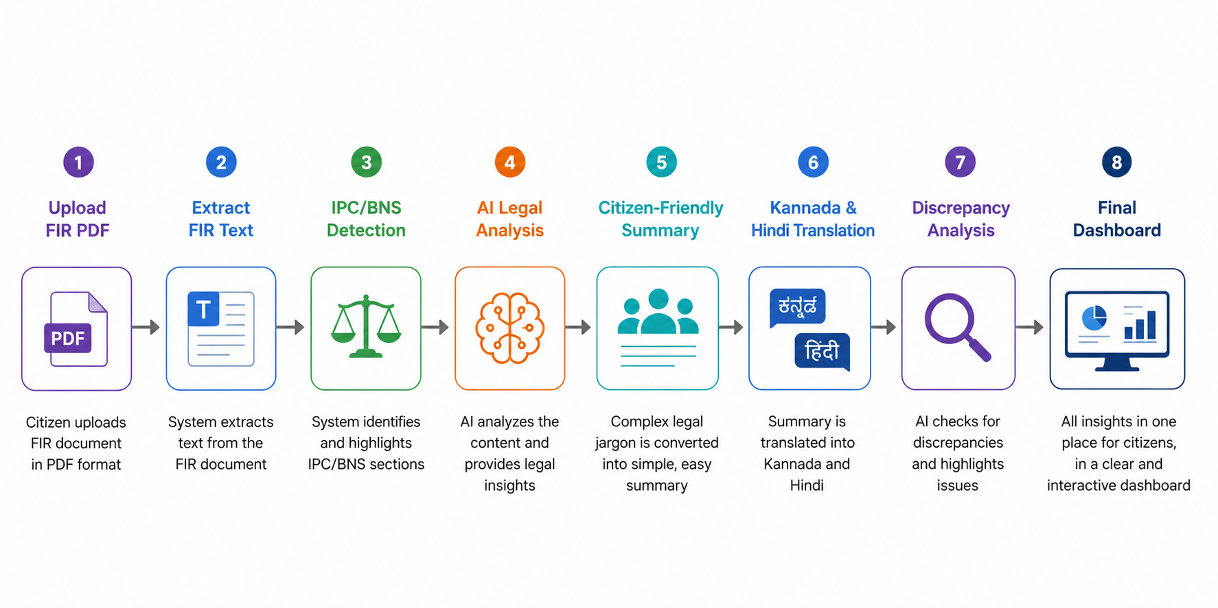
Workflow:

Slide 6
Implementation:
FIR Upload & Text Extraction: The system allows users to upload FIR documents in PDF format through the Streamlit-based interface. The uploaded document is processed using the PyPDF library, which extracts the textual content from the FIR. The extracted text is then prepared for further legal analysis and processing.
IPC/BNS Section Detection:The extracted FIR content is analyzed to identify IPC/BNS sections mentioned in the document. The detected sections are matched with the integrated legal dataset to retrieve relevant legal information. The corresponding section titles and descriptions are then displayed to help users understand the applicable laws.
AI-Powered FIR Simplification: The Gemini 2.5 Flash API is used to generate a simplified version of the FIR. Complex legal terminology and lengthy narratives are converted into clear and citizen-friendly language. This enables ordinary users to understand the key details of the FIR without requiring legal expertise.
AI Legal Explanation: The system utilizes Gemini to provide a detailed explanation of the FIR. It identifies the nature of the crime, highlights important facts, explains possible legal implications, and describes the actions being taken by law enforcement authorities. This feature helps users gain a deeper understanding of the case.

Slide 7
Implementation:
Multilingual Translation: To improve accessibility, the generated legal explanation is automatically translated into Kannada and Hindi using the Deep Translator library. This multilingual support ensures that users can understand FIR information in their preferred language.
Discrepancy Analysis:The original citizen complaint is compared with the official FIR using Gemini-based analysis. The system identifies missing information, mismatched details, and additional information present in the FIR. A discrepancy report is then generated to help users verify the accuracy of the recorded complaint.
AI Crime Classification: The Gemini model analyzes the FIR narrative to determine the likely crime category and applicable IPC/BNS sections. Even when legal sections are not explicitly mentioned, the system uses semantic understanding to classify the crime and provide reasoning behind its prediction. This improves the overall intelligence and adaptability of the solution.

Slide 8
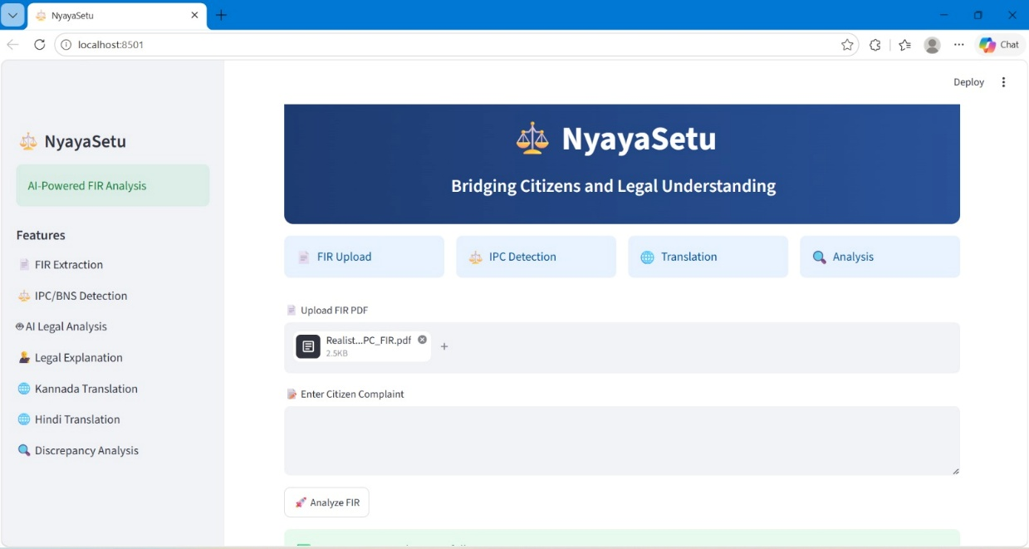
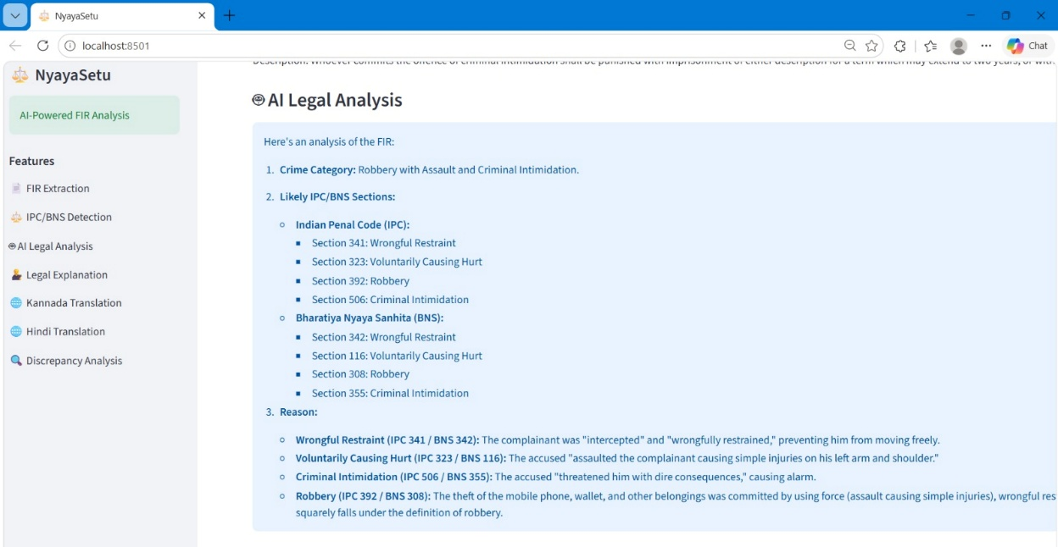
Screenshots:
Fig1: PDF Upload
Fig2: AI Legal Analysis

Slide 9
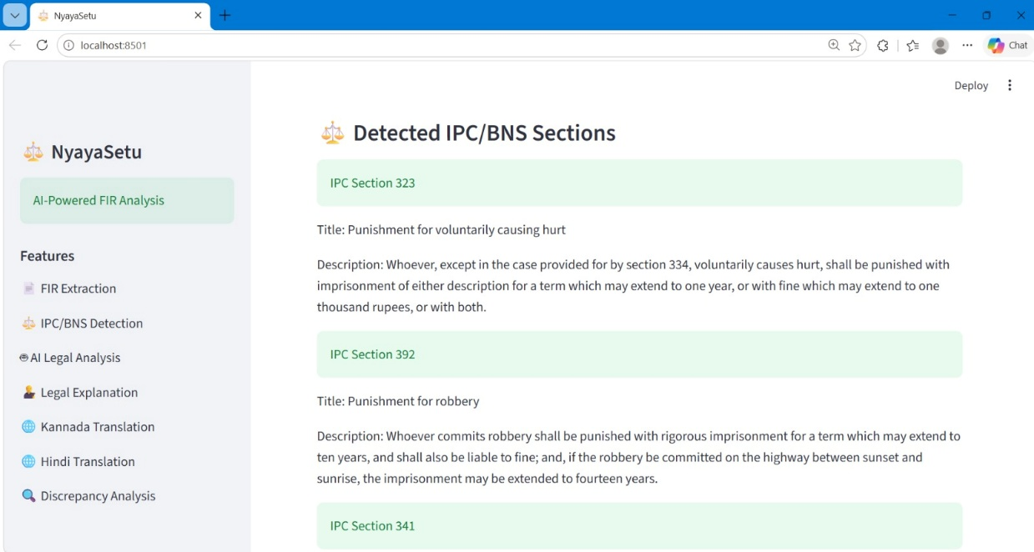
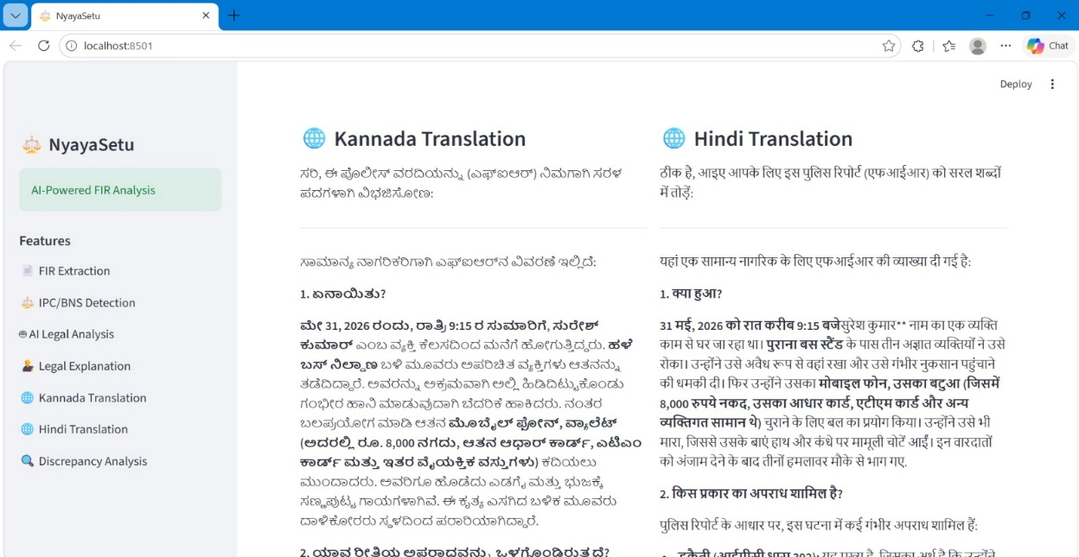
Screenshots:
Fig3: IPC Section Detection
Fig4: Multilingual Translation

Slide 10
Thank You!

